Slide 1

Legislation in Practice

Slide 2
Wine Market in Bulgaria

Slide 3
Table 1: Grape Production and Utilization, 2016 – 2018

Slide 4
PDO-PGI-TSG PRODUCTS

Slide 5
In 1992 according to the regulation 2081/92, the European Union first adopted the system for the protection of geographical indications and the designations of origin of agricultural products and foodstuffs and according to the regulation 2082/92 the rules on the certificates of specific character for agricultural products and foodstuffs. In 2006 to improve the system, the above regulations have been replaced by regulations (EC) 510/06 and (EC) 509/06 respectively, without changing their scope and feasibility.
By Regulation (EE)1151/2012 of 21 November 2012 on quality schemes for agricultural products and foodstuffs the above mentioned regulations ((EC)509/2006 and (EC)510/2006) are merged into a single legal framework. While in this regulation have been added and other quality schemes such as optional quality terms “mountain product”, “product of island farming” etc.
In accordance with the aforementioned regulations and under the reorientation of the Common Agricultural Policy (CAP), the farmers are encouraged to switch to forms of integrated rural development through the diversification of rural production. Furthermore, it is possible the producers (especially in disadvantaged and remote areas) to promote easily their products with special characteristics, achieving better market prices and thereby improving their income and on the other hand consumers to buy quality products with guarantees for the production, processing and geographic origin.

Slide 6
Protected Designation of Origin (PDO)
Designation of origin
‘Designation of origin’ is a name which identifies a product:
(a) originating in a specific place, region or, in exceptional cases, a country;
(b) whose quality or characteristics are essentially or exclusively due to a particular geographical environment with its inherent natural and human factors; and
(c) the production steps of which all take place in the defined geographical area.

Slide 7
Protected Geographical Indication (PGI)
Geographical indication
‘Geographical indication’ is a name which identifies a product:
(a) originating in a specific place, region or country;
(b) whose given quality, reputation or other characteristic is essentially attributable to its geographical origin; and
(c) at least one of the production steps of which take place in the defined geographical area

Slide 8
Traditional Specialities Guaranteed (TSG)
Traditional Speciality Guaranteed Product
A name shall be eligible for registration as a ‘traditional speciality guaranteed’ where it describes a specific product or foodstuff that:
(a) results from a mode of production, processing or composition corresponding to traditional practice for that product or foodstuff; or
(b) is produced from raw materials or ingredients that are those traditionally used.

Slide 9
Competent Authorities for official controls
In Greece, since 1.6.2006, EL.G.O. DEMETER (former AGROCERT), has been authorized to grant certification to enterprises, to carry out controls in cooperation with the Directorates of the Rural Development of the Prefectures, to ensure compliance with the specifications, to certify the products in question as well as to keep a register of the enterprises approved for the usage of PDO and PGI indications.

Slide 10
Submission and scrutiny procedures for registration applications
Application Submission and Scrutiny
The applicant group shall submit the registration application to the Directorate of Organic Agriculture of the Ministry of Rural Development and Food (Section PDO-PGI-TSG) Acharnon 29, Athens P.C 104 39.
The folder shall include:
a) the registration application according to the model of the Annex I of the C.M.D 261611/2007 as amended by the C.M.D 290398/2008.
b) the single document according to the model of the Annex I of the Reg. (EC) 1898/2006
c) the product’s specifications
d) a statement that the conditions of article 2 of the Regulation 1898/2007 are met in the case where the interested party is a natural or legal person.

Slide 11
The folder is assessed in the first stage, for the completeness and quality of the submitted data by the Section of PDO-PGI-TSG of the Directorate of Organic Farming of the Ministry of Rural Development and Food. In case the application is justified and complies by the regulations, then the relevant request is widely publicized at national level and national objection procedure is initialized. Any natural or legal person having a legitimate interest and established or resident in Greece may lodge an objection to the application. After the examination of the objections, if any, the application is either accepted at national level or rejected. In any case, a relevant decision of the Minister of the Rural Development and Food is issued.
Then, the folder is communicated to the European Commission to be scrutinized at second stage. Where the Commission considers that the conditions are met, the single document is published in the Official Journal of the European Union. Any legal or natural person having legitimate interest at international level, may object to the proposed registration. Following the objections’ examination, the designation is registered to the Community Register for the Protected Designations of Origin and the Protected Geographical Indications. In case the application is finally rejected by the Commission, the relevant Ministerial decision is recalled.
The use of the indications POD PGI may start from the date of issue of the EU registration regulation.

Slide 14
EU and National Legislation
EU Legislation
Regulation (EU) 1151/2012 of the 21/12/2012 on quality schemes for agricultural products and foodstuffs
COMMISSION IMPLEMENTING REGULATION (EU) No 668/2014 of 13 June 2014 laying down rules for the application of Regulation (EU) No 1151/2012 of the European Parliament and of the Council on quality schemes for agricultural products and foodstuffs
COMMISSION DELEGATED REGULATION (EU) No 664/2014 of 18 December 2013 supplementing Regulation (EU) No 1151/2012 of the European Parliament and of the Council with regard to the establishment of the Union symbols for protected designations of origin, protected geographical indications and traditional specialities guaranteed and with regard to certain rules on sourcing, certain procedural rules and certain additional transitional rules
COMMISSION DELEGATED REGULATION (EU) No 665/2014 of 11 March 2014 supplementing Regulation (EU) No 1151/2012 of the European Parliament and of the Council with regard to conditions of use of the optional quality term ‘mountain product’
National Legislation
Common Ministerial Decision (CMD) 261611 (O.G no.406/22-3-2007, issue B) with additional measures of the Reg. 510/06 and 1898/06
CMD 290398 (O.G no 694/21-4-2008 issue B) amending the CMD 261611/2007
CMD 318764 (OG no 1683/21-08-2008 issue B) amending the CMD 261611/2007

Slide 15
Indigenous varieties of winemaking

Slide 16
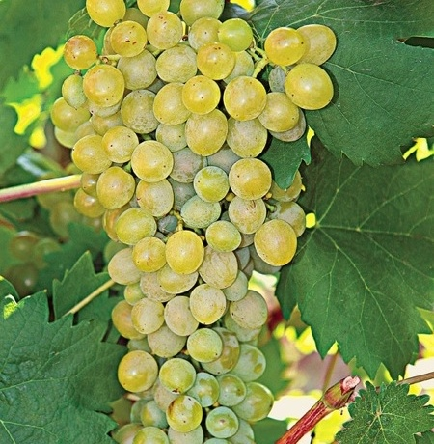
Athiri
Athiri is one of the most ancient Greek grape varieties. The name of the grape indicates its origin from the island of Santorini, also known as Thira, where it is used together with Assyrtiko and Aidani for the production of AOC Santorini wines. Athiri is found in other regions in Greece including Macedonia, Attica and Rhodes where it produces
AOC Rhodes wines. Athiri grapes have a thin skin and give sweet and fruity juice. It produces wines slightly aromatic, having medium alcoholic content with low acidity.

Slide 17
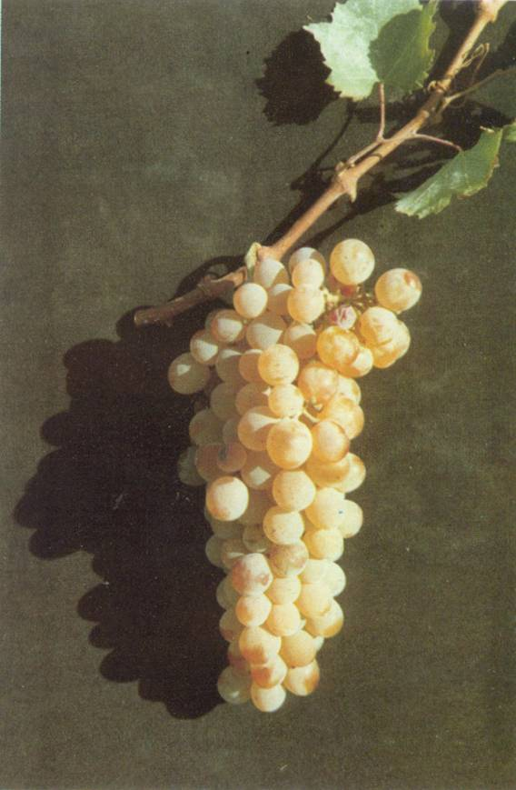
Assyrtiko
Assyrtiko is one of Greece’s finest multi-purpose (white grape varieties. It was first cultivated on the island of Santorini, where it has developed a unique character producing excellent AOC wines. Assyrtiko has the ability to maintain its acidity as it ripens.
It yields a bone-dry wine that has citrus aromas mixed with an earthy, mineral aftertaste due to the volcanic soil of Santorini. In the last 25 years Assyrtiko has been planted throughout Greece including Macedonia and Attica where it expresses a milder and more fruity character. Assyrtiko can also be used together with the aromatic Aidani and Athiri grapes for the production of the unique, naturally sweet wines called VINSANTO (wine from SANTOrini), well known since Byzantine times.

Slide 18
Aidani
Aidani is another ancient Greek grape variety and is mainly found in the Cyclades Islands. It produces wines pleasantly aromatic with medium alcoholic content and acidity. It can be successfully mixed with grapes having a high alcoholic content and acidity such as Assyrtiko.

Slide 19
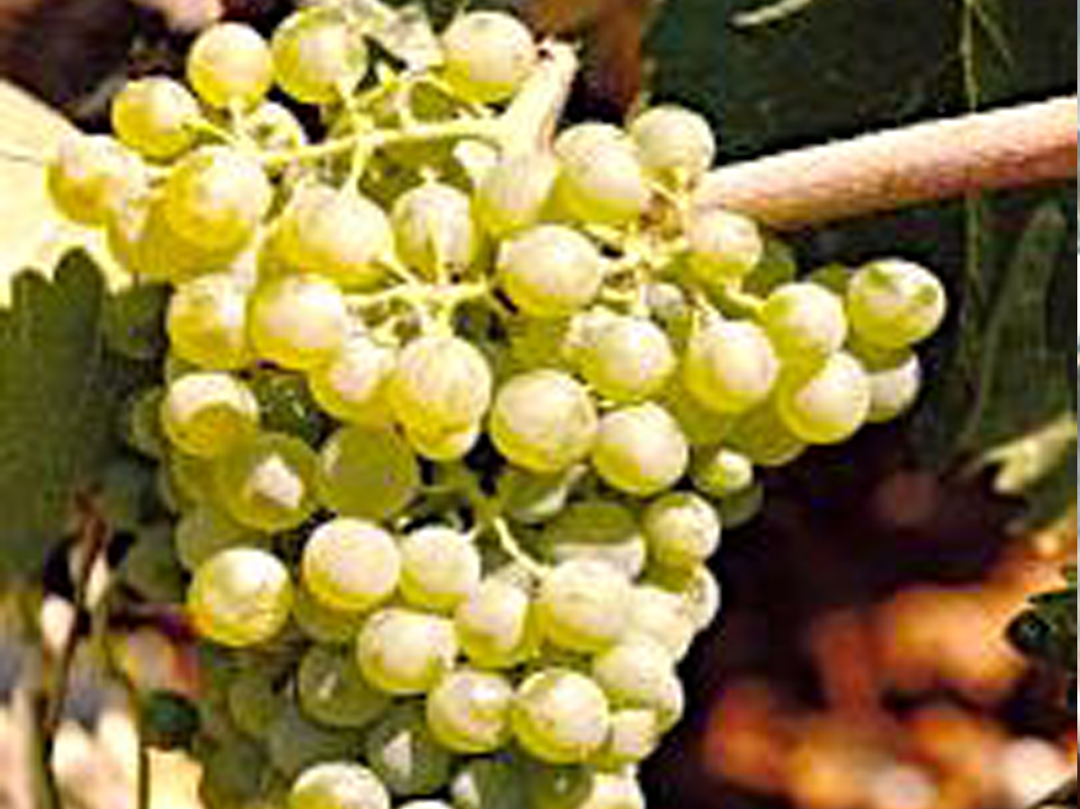
Lagorthi
A very promising grape originating in Kalavrita in the
Peloponnese. Since its revival, the Lagorthi grape is
cultivated mainly on the slopes of Aegialia at an altitude of 850m. Lagorthi grapes produce wines with medium levels of alcohol that have a pronounced acidity derived primarily from the malic acid content of the grape. Its elegant aroma combines hints of peach, melon and basil together with citrus and mineral flavours.

Slide 20
Malagousia
A white variety originating from Etoloakarnania and cultivated in Macedonia (Halkidiki, Thessaloniki) and here and there in Central Greece (Etoloakarnania, Phthiotis, Attica) and the Peloponnese. It ripens in late August. Malagousia may yield barrel-fermented or barrel-aged wines that have a high alcoholic strength, a distinctive, rich aroma, medium acidity and a full and well-rounded palate. It is used in making certain Vins de Pays (of Epanomi, of Sithonia).

Slide 21
Debina
A remarkable white variety of Epirus, grown mainly in Zitsa and sporadically in other regions (Arcadia, Thesprotia,Thessaloniki, Karditsa, Larissa and Trikala), spanning a total 750 hectares.
It ripens after mid September and yields dry wines with medium alcoholic strength, a distinctive fruity aroma and crisp palate as well as semi-sparkling wines of note. Debina produces the dry still wines, and the dry and semi-sweet sparkling wines of Zitsa (V.Q.P.R.D. and V.M.Q.P.R.D. "Zitsa" respectively) as well as the Vin de Pays of Ioannina.

Slide 22
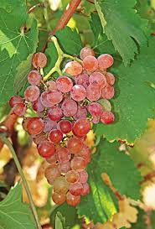
Roditis
As the name implies, Roditis is a rosé colored grape that is very popular in Attica, Macedonia, Thessaly and Peloponnese where it is cultivated for the production of AOC Patra wines. It produces the best results when cultivated with low yields on mountainous slopes. Roditis produces elegant, light white wines with citrus flavors and a pleasant aftertaste.

Slide 23
Vilana
A white Cretan variety found in the prefectures of Herakleion and Lassithi and sporadically in the prefectures of Rethymno and Chania, on cultivated
expanses spanning approximately 350 hectares. It
ripens after mid September.
When Vilana is cultivated in suitable soil with a low
yield per vine, it yields wines of average to high alcoholic strength, high acidity and with a mediocre
aromatic potential. This variety is easily oxidised and requires constant attention during wine-making.
Vilana is used to produce the dry white V.Q.P.R.D. "Peza" (100%) and "Siteia" (together with the Thrapsathiri variety) as well as certain Vins de Pays (Kritikos [Cretan], Lassithiotikos [of Lassithi], of Kissamos, Irakleiotikos [of Herakleion]).

Slide 24
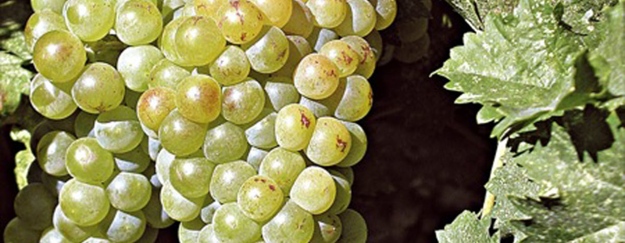
White Muscat
An aromatic grape which leads to the production of
excellent dessert wines and interesting dry whites. Fresh or aged, natural or fortified the dessert Muscat wines are ready to please even the most difficult wine enthusiast. It is cultivated in many regions of Greece but is known to produce the best results and AOC wines in Samos, Patra and Rio of Patra. It also yields a small production of AOC Rhodes and Cephalonia wines.

Slide 25
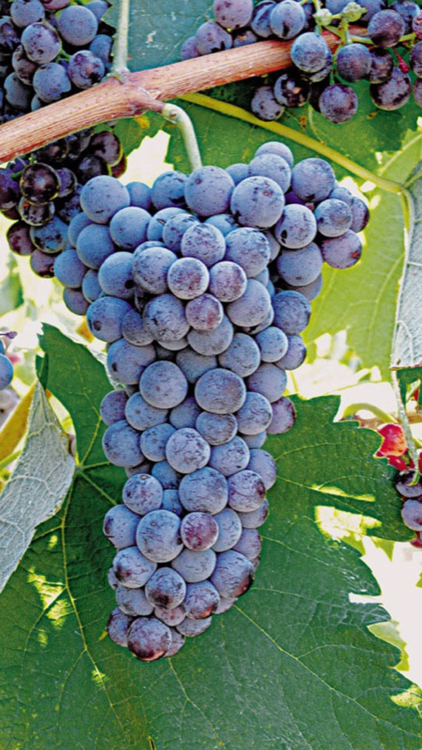
Moschofilero
A distinct aromatic grape from the AOC region of
Mantinia, in the Peloponnese, Moschofilero grapes have a blue-gray colored skin and therefore produce a wine that is a “blanc de gris”. Its crisp character and beautiful floral aroma of roses and violets with hints of spices can be drunk as an aperitif or with food.

Slide 26
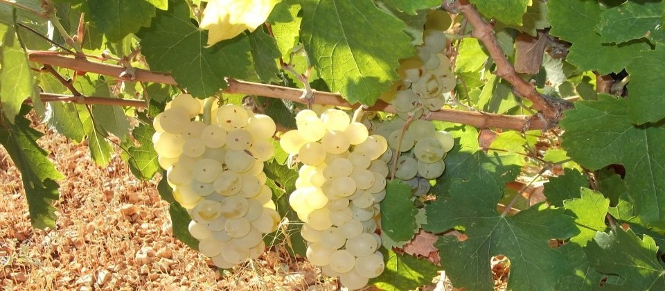
Robola
Grown most notably in the mountainous vineyards of Cephalonia, the noble Robola grapes yield distinguished wines with citrus and peach aromas mixed with smoky, mineral hints and a long lemony aftertaste. Robola’s fine character assisted in its qualification as the AOC Robola of Cephalonia.

Slide 27
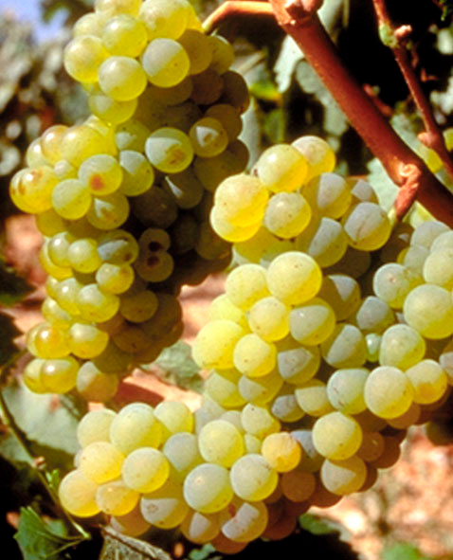
Savatiano
A white variety mainly grown in the prefectures of Attica, Evia, Viotia and, to a lesser extent, in the Cyclades, Western Crete, Peloponnese and Macedonia, on more than 18.000 hectares. It has average vigour, is fertile, productive and resistant to drought. Savatiano is adapted to different soil types but yields better quality wines if grown on dry, limy soil of average fertility. It ripens in mid September.
A rather misjudged variety, Savatiano can yield remarkable white wines with a fine aroma and balanced taste if it is planted at relatively high altitudes, is not overloaded and is harvested when it has reached its prime ripeness. It otherwise produces rather high-alcohol, low-acidity wines. Savatiano is blended with Roditis to make the dry white V.Q.P.R.D. "Anghialos". It is used in making a number of Vins de Pays (Geranion, Karytsinos [of Karystos], Markopoulou [of Markopoulo], Palliniotikos [of Pallini], Peanitikos [of Peania], Ritsonas [of Ritsona], etc.), wines with the Traditional Appellation Retsina as well as Table wines.

Slide 28
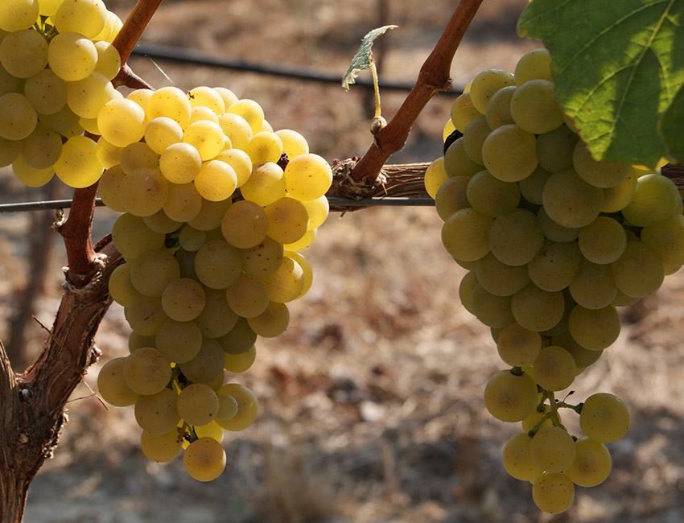
Tsaoussi
A very interesting Mediterranean variety producing
pleasant light wines with fruit and honey aromas. This grape is now found mainly on the island of Cephalonia where it usually blends well with the local Robola giving well structured wines.

Slide 29
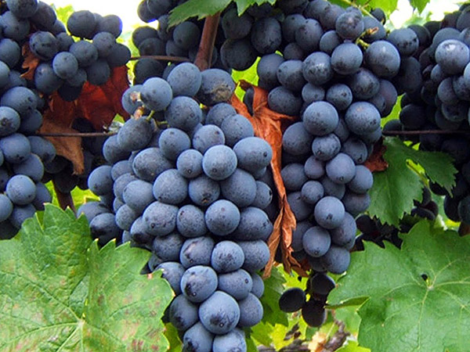
Red Varieties
Xynomavro
Xynomavro is one of the two most highly regarded Greek red cultivars (Agiorghitiko being the other). It
is ubiquitous in Macedonia but is best known for the role it plays in the wines of Naoussa. It is the sole variety permitted under the Naoussa and Amyntaio (OPAP) appellations and one of two (with Negoska) under the Goumenissa appellation. Xynomavro is regarded as the most unwieldy of the major Greek cultivars. Temperamental and unforgiving, its wines are greatly affected by weather, so that vintage often means more in regard to quality of Xynomavro than to most other Greek wines.

Slide 30
Aghiorghitiko
One of the most noble of the Greek red grapes, Aghiorghitiko (meaning St.George's) is grown mainly in the AOC region Nemea in Peloponnese. It produces wines that stand out for their deep red color and remarkable aromatic complexity. Aghiorghitiko’s soft tannins, in combination with its balanced acidity lead to the production of many different styles of wine, ranging from fresh aromatic reds to extraordinary aged reds. It also produces pleasant aromatic rosé wines.

Slide 31
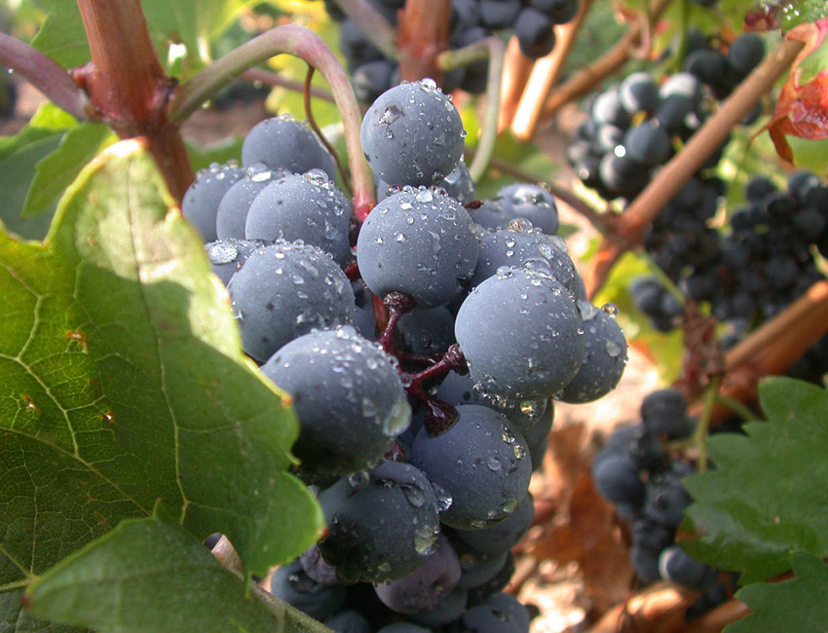
Krassato
A red Thessalian variety mainly grown in the region of
Rapsani. It ripens in late September. Krassato yields high-alcohol wines of medium acidity and chromatic intensity that are rich in tannins and age quickly. It is blended with Stavroto and Xinomavro varieties to produce the dry red VQPRD V.Q.P.R.D. "Rapsani".

Slide 32
Moschomavro
A red variety grown over a small area in Western Macedonia (Grevena, Kozani) and sporadically in Thessaly (Karditsa, Trikala).
It is a vigorous, robust, fertile, productive variety susceptible to botrytis and acid rot and relatively resistant to periods of drought. It ripens after mid September.
Moschomavro yields high-alcohol, balanced-acidity wines that are mildly aromatic and have a medium colour.
It is used in making the Vin de Pays of Grevena.

Slide 33
Stavroto
A red variety grown in the prefecture of Larissa, mainly at Ambelakia and Rapsani and sporadically at Trikomo, Grevena, and in the prefectures of Kozani and Magnesia.
It ripens in late September to early October.
Stavroto yields wines of average alcoholic strength and
acidity, medium colour and enough tannins, which do not age well. It is blended with Krassato and Xinomavro to produce the dry red V.Q.P.R.D. "Rapsani".

Slide 34
Limnio or Kalambaki
Limnio is universally believed to be the ancient variety Limnia, mentioned by both Polydeuctes and
Hesiodos. The name denotes its origin on Limnos, one of the Aegean Islands. On Limnos itself, the grape diminished in importance with the rise in dominance of Moschato Alexandreias, the only cultivar on the island to achieve appellation status.
Limnio vines are hardy and late-ripening, producing
herbaceous wines of considerable body (alcohol) and extraction.

Slide 35
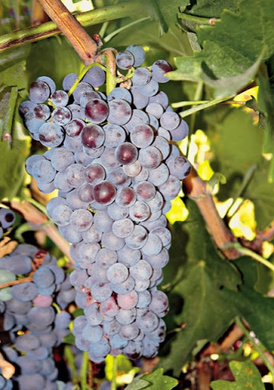
Negoska
Negoska (or Negotska), an important variety in Macedonia, derives its name from the Slavic word for Naoussa, Negush and is believed to be a close relative of Xynomavro. Negoska is nevertheless associated at present more with Goumenissa, where its higher sugar content and riper, berry-like fruit are ideal for rounding out
the more austere Xynomavro in Goumenissa OPAP reds. The appellation stipulate an admixture of Xynomavro with a minimum of 20% Negoska.

Slide 36
Kotsifali
One of the most notable red varieties in Crete, largely cultivated in the prefecture of Herakleion.
It ripens in late August to early September.
The Kotsifali yields high-alcohol, aromatic wines of low acidity and unstable colour. For this reason it is blended with the Mandilaria variety, which is known for its intense colour and high phenol content, in order to produce the dry red V.Q.P.R.D. "Peza" and "Archanes". Kotsifali is also used in making certain Vins de Pays (Kritikos [Cretan], Lassithiotikos [of Lassithi], Irakleiotikos [of Herakleion]).

Slide 37
Mandelari or Mandelaria or Amorgiano
Mandelaria grape, rich in color, is also known as
Amorgiano. It is mainly cultivated on the islands
of Rhodes and Crete. Mandelaria participates in
various Appellations of Origin, usually with other
grapes such as Monemvassia in Paros, Kotsifali
in Crete or as a single variety on the island of
Rhodes, producing distinctive red wines.

Slide 38
Mavrodaphne
Mavrodaphne, meaning black laurel, is mainly found in the Peloponnesean regions of Achaia and Ilia as well as the Ionian Islands. It is blended with Korinthiaki grape to produce a delicious fortified dessert wine known as Mavrodaphne. It also yields very good results when blended with Refosco, Agiorghitico and Cabernet Sauvignon grapes.

Slide 39
Future Prospects in Greece. SWOT analysis for wine and table grapes.

Slide 40
Introduction
Greece is experiencing the consequences of the hardest financial crisis of its history. The economic crisis in Greece, have a great impact on unemployment and as a result companies are out of business and many people especially young ones are unemployed. In addition, economic crisis, from one hand leads more and more people, special young people with many skills to leave from Greece to other countries and from the other hand, turns young unemployed people to the agricultural sector.
The current project’s aim is to determine the potential of viticulture, table and grape varieties in Greece could be an answer for recharging youth and if this sector could improve the national economy and reverse this negative trend. Grape cultivation and wine making have a distinguished place in the history of Western civilization. The ancient Greeks gave an importance to wine, which greatly exceeded its role as a beverage. The production of wine and table grape has been an important part of Greek culture for many centuries. Nowadays Greece holds the 13th place on vineyard surface area. It is one of the first table grape producing (4th) countries in Europe, first producer of currants (Black Corinth) of the world production and eighth exported country in dried grapes worldwide.

Slide 41
SWOT analysis was conducted for this sector which revealed the fact that this sector is valuable and with appropriate choices can recharge youth. Results showed that there is a great potential for table grapes in Greece and for wine grapes could be potential if the problem with the limited available plating rights to establish new vineyards, will be resolved.

Slide 42
SWOT analysis for wine and table grapes
Strengths
Favorable Climate and soil conditions: The soil types that exist in Greece and their specific physicochemical properties combined with the variation of temperature, precipitation and sunshine have a positive impact on the quality of the produced wine.
Long tradition and experience on vine cultivation: Greece is in the 13th position in the world areas under vines. The cultivation of vine has been an important part of Greek culture for over 4000 years.
Established organic and integrated farm management systems: The implementation of such quality system give added value to the final product.
Possession of specialized cultivation equipment: As viticulture in Greece passes from generation to generation and it consists a part of the family tradition almost always there is the availability of such equipment.

Slide 43
Weaknesses
Small size and large number of fields per agricultural holdings: Restricting distribution of planting rights prevents the transition and creation of large-scale vineyards. In 2019 about the agricultural holdings of small or medium average size (5.8 hectares) were estimated at 717.000.
Lack of skills in marketing and trading: Very few producers consider important market research and marketing. Even those who so desire, lack the skills and knowledge to perform.
Aged rural population: According to statistics, the majority of farmers are aged between 40-64 years old (66,7%).
High initial cost of land, vineyard establishment and required equipment: It is a major deterrent to the creation of large-scale, modernized vineyards, equipped with the necessary agricultural machinery, especially at times of economic crisis we are experiencing.

Slide 44
Long period to reach full production: In nature, the vine takes 3-4 years to deliver maximum production.
Insufficient resources for viticulture education: Producers rely on their own empirical knowledge and their parents knowledge, rather than new cultivation techniques.
Limited cash flow: Capital controls imposed by the Greek Government such as transaction taxes, other limits, or outright prohibitions that regulate flows from capital markets into and out of the country's capital account restrict the availability of cash.

Slide 45
Opportunities
Interest by potential new farmers: Young people who want to get involved with the cultivation of wine and table grapes are: on the one hand farmers who produce other agricultural products and are disappointed by the yields or sales prices of the products and on the other hand the children of the vine grape producers.
New emerging markets for wine and table grapes (Russia, China): To achieve penetration into new emerging markets, the products need to have the necessary certificates in order to be accepted, in the phase of cultivation (integrated and organic agriculture) and then at the stages of packaging and standardization.
Decreased Euro exchange rate favors Greek exports to other non-European countries: Due to the fall in the price of wine, the Greek wines and table grapes, have become more competitive on other continents.
Increased popularity of Mediterranean cuisine: The Mediterranean diet combined with the nutritional value of wine (polyphenols) has a positive effect against cardiovascular disease and combat cholesterol. Table grapes are an integral part of the Mediterranean diet.

Slide 46
Threats
Climate change: Climate change such as extreme temperatures and extreme weather conditions adversely affect the biological cycle of the plant and therefore the yield and quality of the final product.
Limited access to financing: it is fact that for someone to enter the sector needs considerable amount of money because of the high initial installation costs. Therefore due to the economic crisis in Greece funding through banks has become very difficult.
Registration of Greek vine varieties by other nations and importation of certified propagation material: to replace the imported, the state must create an organization to start the Greek certification of propagation material for grapes.

Slide 47
SWOT analysis specialized for Wine grapes
Strengths
Established brand name of Greek wine grapes: many Greek wines have won awards and distinctions in many international competitions.
Weaknesses
Lack of certified propagating material of native wine varieties: As in Greece there is no national propagation material registry it is impossible to certify the native wine varieties. Although there are non desirable, the solutions are to import them from other countries or use those who have been produced in non approved nurseries.
Opportunities
Increased tendency to appreciate native wine varieties: The range and quality of local varieties are very remarkable and should exploit, because the foreign varieties to a large extent they may be replaced.
Synergies with agro tourism: Agro-tourism is a specialized type of tourism and especially wine tourism, has a great impact in many peoples in the world. The interviews of wine producers indicate that only those who have wineries are involved in wine tourism, but great part of the others producers, expressed their interest to do it.
Emerging on-line services for wine grapes: wineries not pursue retail sale through their website, because they conflict with the interests of wholesalers.

Slide 48
Threats
Restricted planting of new vineyards for wine grapes: The distribution of rights in hectares per producer should be increased, especially for young farmers, in order to allow the sector to develop further and extend.
Reduction of domestic and European wine consumption: Because of the economic impact, consumption of wine has stabilized, with a downward trend however, and possibility for further decrease due to VAT increases.
Increased taxes on wine: It is a negative fact which directly affects the demand for the consumption of wine and draws consumers to cheaper beverages such as beer and bulk wine.
Imports of cheaper wines competitive products from non-European countries: We should highlight the Greek varieties in order to give the consumer an incentive to try and to prefer them instead of imported.

Slide 49
SWOT analysis specialized for Table grapes
Strengths
Proven health benefits of currants: It is a product of high nutritional value due to the high content of valuable nutrients such as antioxidants / polyphenolic components and fiber, but also the role that appears to play in maintaining health and preventing chronic diseases.
High yields for table grapes: The particular soil and weather conditions in Greece favoring the high productivity and yield, in combination with the special cultivation techniques used by growers by region.
Strong export activity of table grapes: The table grape varieties, especially the variety sultanina has an extremely positive trades balance.
Established brand name of Greek table grapes: The high export rates combined with years of tradition and culture and the certificates they hold, have created a strong brand name.

Slide 50
Weaknesses
Low level of vertical integration for table grapes: Due to lack of knowledge and limitation of funding, the producers are unable to undertake the vertical integration of production, "from field to shelf".
Threats
Reduction in domestic consumption of table grapes due to the economic instability. The domestic consumption in Greece, the last ten years, seems to increased, but if the economic crisis continue, probably it will be decreased.

Slide 51
Stakeholder Analysis
The most significant stakeholders are: a) the consumers which are the moving power of the whole system whose demand the sector has to satisfy, b) the banks to give the capital to the farmers to establish a vineyard, c) the Wholesalers, which have from the great influence on the sector due to they set the prices, d) farmers, labor, pesticides and fertilizers supplies, machinery and equipment supplies and propagation materials supplies, collaborate in order to realize primary production, e) the certification bodies are major stakeholder since most of the crops are organically cultivated, f) Ministry of the governments, play important role are as they the legislative mechanisms that define the rules of the system (planting rights), while they supervise the implementation of the rules by all parts.

Slide 52
Other stakeholders with high influence especially for processed products are the processing units who could attempt to low price of grower in order to maximize their profit and some times that happens deliberately. In cases when the grower also processes the grapes on his own he has to comply with the health safety regulations.
The stakeholder’s category equipment suppliers, packaging materials suppliers and consultants contribute to the processing of table grapes and wine, in order to have end products ready to be bought by consumers. Finally, there are some other stakeholders (hotels, restaurants, Cellars, Environmental and Agricultural authorities etc) with no or some importance, which have some or no influence and are integral part of the sector of viticulture, table and wine grapes.

Slide 53
Table. Stakeholder analysis

Slide 54
Conclusion
Viticulture of table and wine grapes sector from ancient times has always been a significant part of Greek tradition. This results in considerable prior experience in agriculture and viticulture and the “Know-how” in cultivation and processing techniques. Furthermore, the long tradition and experience on vine cultivation is due to the favorable and diverse climate and soil conditions.
The problems created by the financial crisis affected negatively the investment sector and cash flow. The high initial cost of land, vineyard establishment and required equipment as well as the new recent taxes imposed on wine has made the sector quite inaccessible.
The lack of certified propagating material of native wine varieties and inadequate research on Greek wine grape varieties are some of the main weakness that minimize the opportunity of the sector becoming more competitive against other countries.
The establishment of organic and integrated farm management systems, the promotion of nutritional value and proven health benefits of wine, table grapes and currants will make the sector more competitive.
Finally, synergies with agro tourism are proven to have a great positive impact on the promotion of the sector especially for the wineries.

